Slide 1
Problem Track- Omnidimension Public Transit & Fleet Scheduling
IOT BASED BUS TRACKING SYSTEM
MEMBERS
1) SUBHADIP PAUL
2) SUMIT TIWARI
3) UTSHO BANERJEE
4) SUNETRA GHOSH

Slide 2
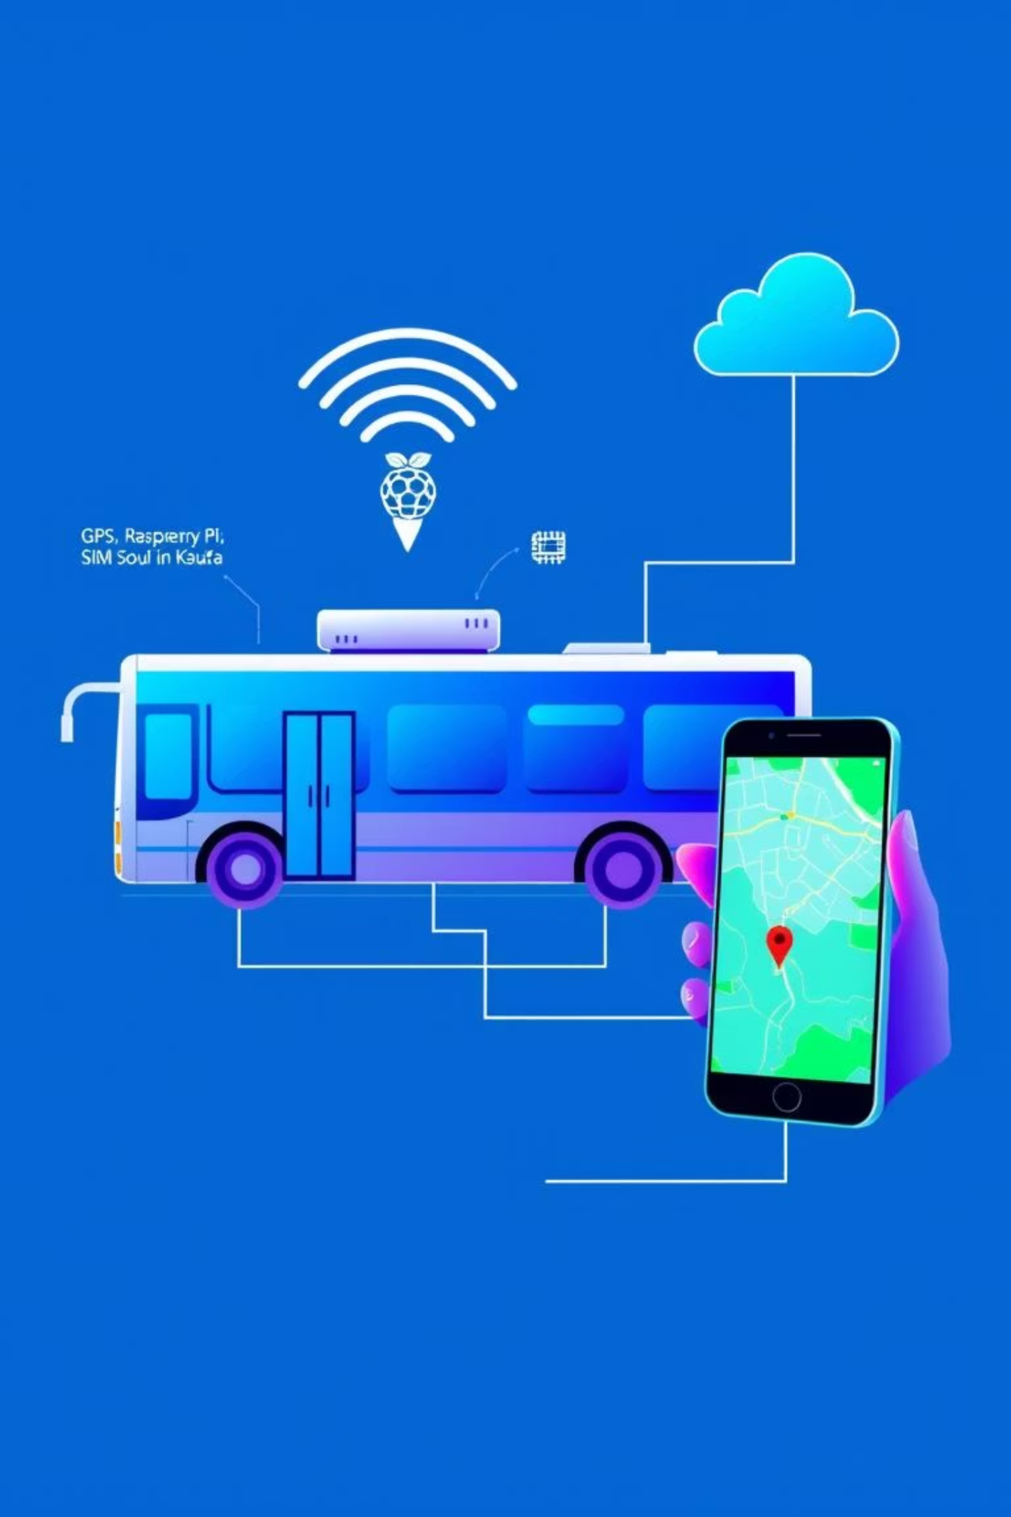
ABSTRACT
Objective
Components
Real-time bus location tracking using IoT and cloud technologies.
GPS module, Raspberry Pi, SIM module, Azure IoT Hub, MQTT, Kafka, Next.js, Socket.io.
Benefit
Enhanced public transportation efficiency through real-time tracking and improved user experience.

Slide 3

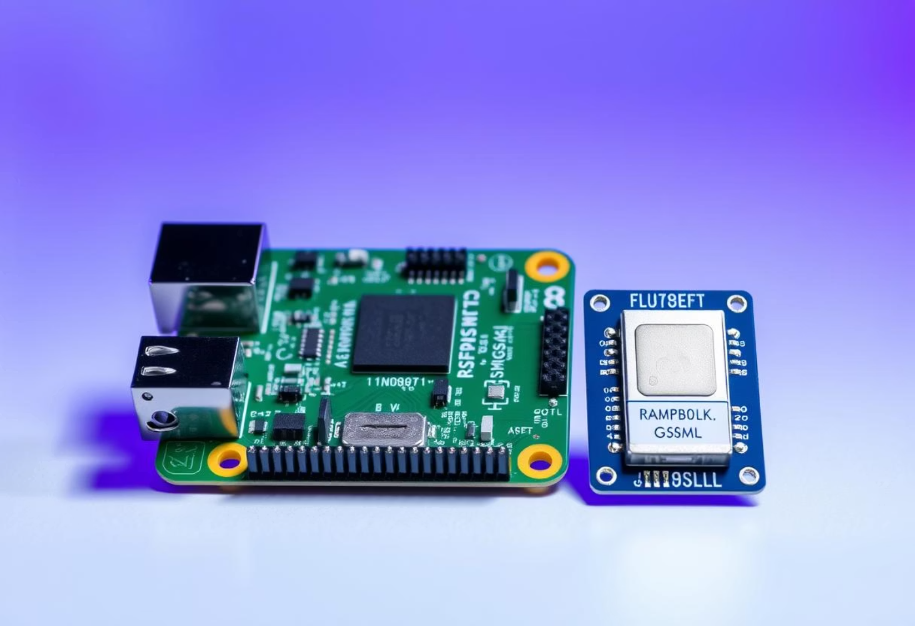


HARDWARE REQUIRED:
Raspberry Pi
Microcontroller
NeoGM GPS
Tracking bus location
Sim 800L GSM
Communication module

Slide 4

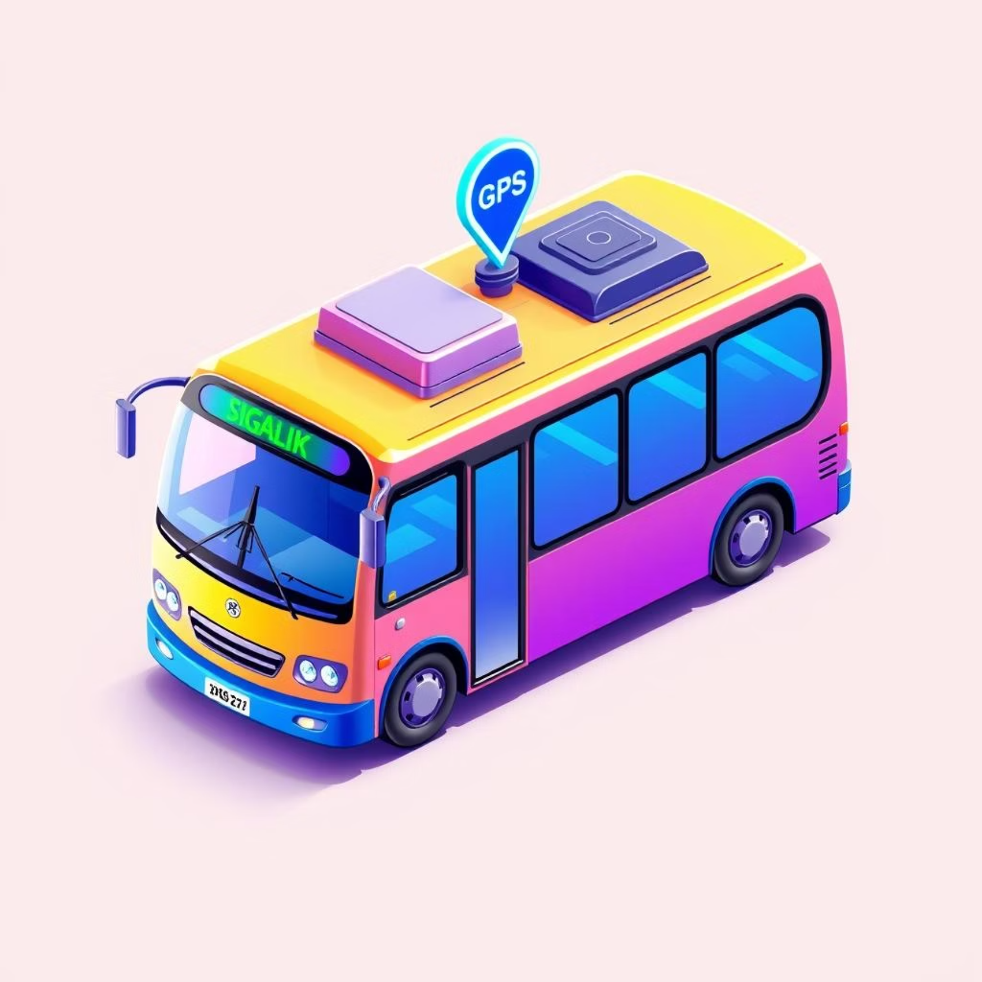






PROCEDURE:
GPS Module Captures Location
The GPS module on the bus continuously collects latitude, longitude, and speed data.
Arduino Processes GPS Data
The Arduino reads the GPS data and formats it for transmission.
SIM Module Sends Data
The SIM module (GSM/GPRS/LTE) transmits the processed data to Azure IoT Cloud using the MQTT protocol.
Azure IoT Hub Receives and Forwards Data
Azure IoT Cloud Hub receives the incoming GPS data and sends it to Kafka for real-time processing.
Kafka Handles Data Streaming
Kafka acts as a message broker, managing the data stream efficiently and forwarding it to the Next.js server.
Next.js Server Processes and Broadcasts Data
The server listens for incoming location updates from Kafka and uses Socket.io to send them to connected clients.
Frontend Displays Live Location
The Next.js frontend updates in real time, showing bus locations as well as average speed on mobile phone.

Slide 5
SETTING UP CLOUD:
Create an Azure IoT Hub
Register the Device (Arduino with SIM Module)
Install MQTT Library on Arduino
We log into Azure Portal, navigate to IoT Hub, and create a new hub with the required configurations.
In IoT Hub, we create a new IoT device and note down the Connection String (used for MQTT communication).
We use the PubSubClient library in Arduino to enable MQTT communication.
Connect Arduino to IoT Hub
Set Up an Azure IoT Hub Route
Process Data in Kafka
We set up the MQTT broker as Azure IoT Hub's MQTT endpoint. We use the device connection string for authentication. We publish GPS data to a specific IoT Hub Topic.
We configure Kafka to receive the data from Azure IoT Hub and distribute it to the Next.js server.
We create an Event Hub-compatible endpoint in IoT Hub to forward incoming data to Azure Stream Analytics or Kafka.
Real-Time Updates to Frontend
The Next.js backend receives data from Kafka and pushes updates to the frontend via Socket.io, displaying the bus location in real time.

Slide 6
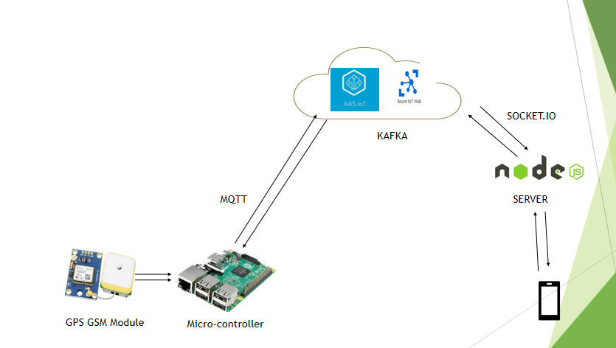
PROJECT DIAGRAM

Slide 7

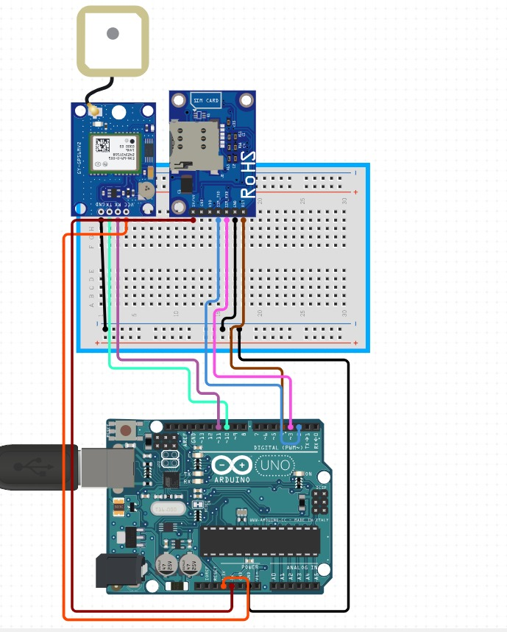
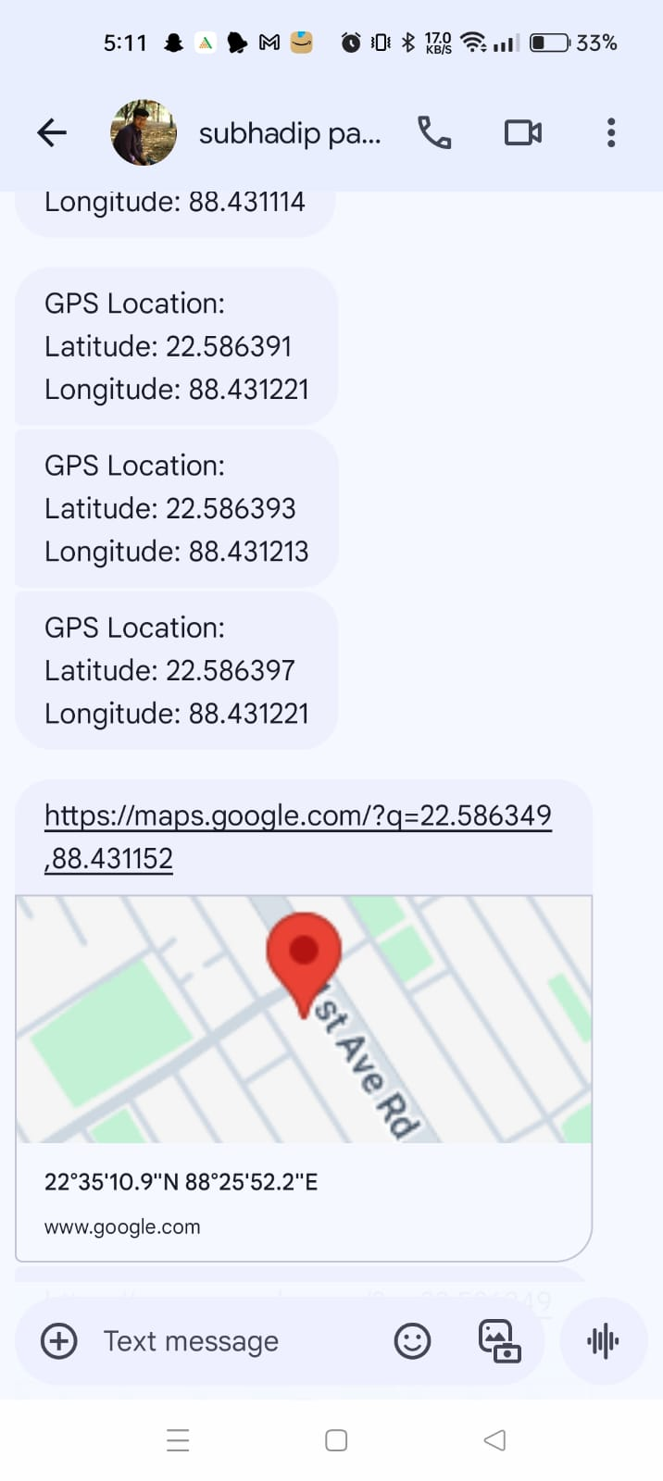
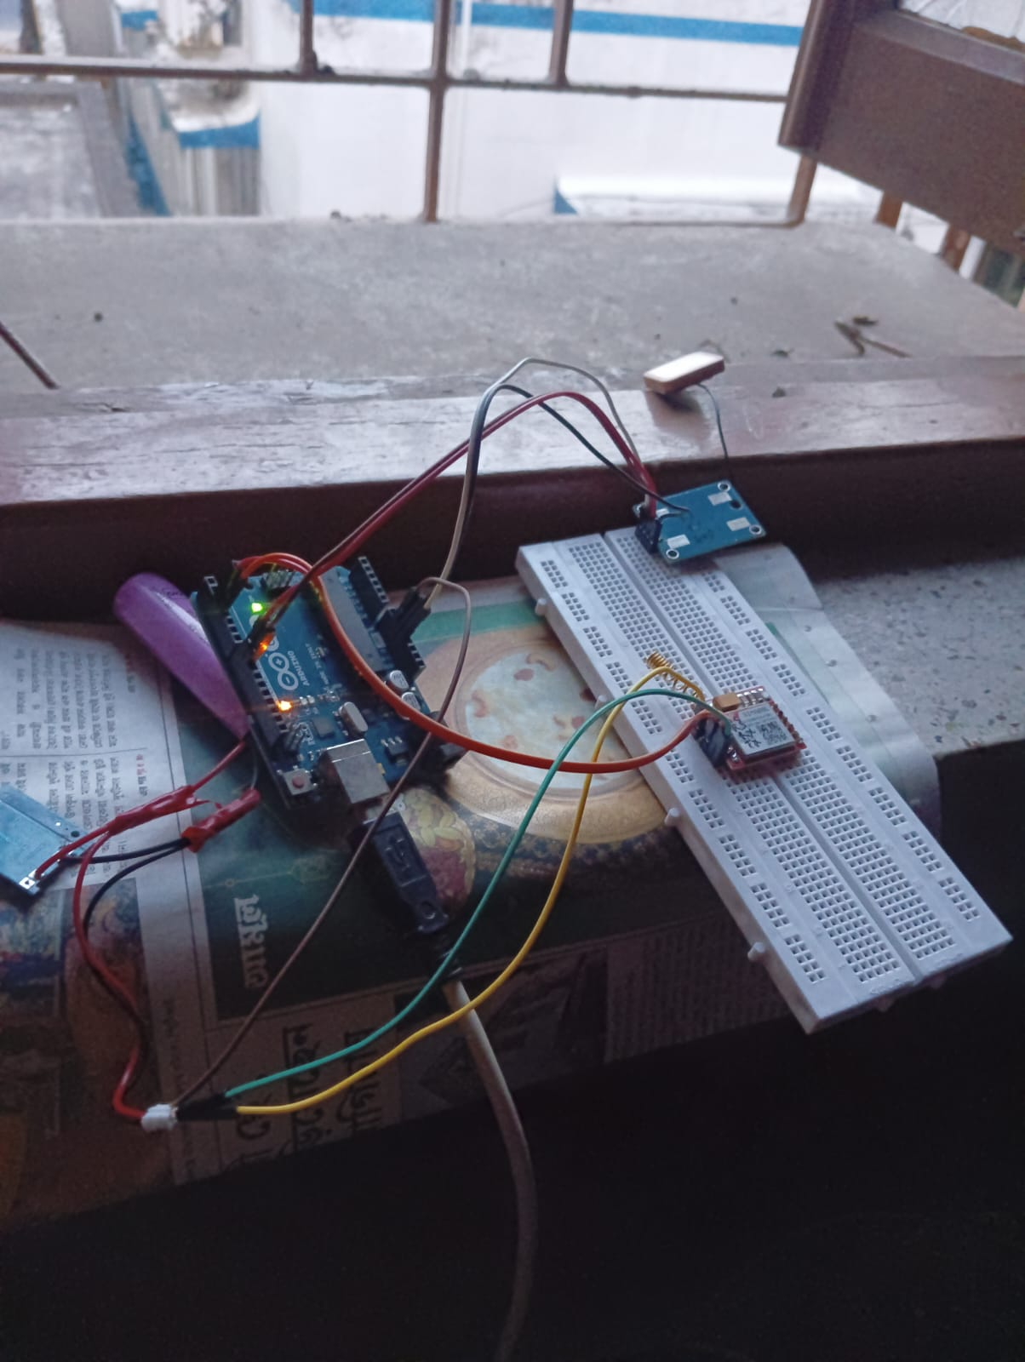
IMPLEMENTATION
Hardware Integration
Raspberry Pi processes GPS signals from the NeoGM GPS module. SIM 800L GSM module transmits data wirelessly.
Data Ingestion and Processing
Azure IoT Hub ingests device data. Kafka streams location data to the backend.
Frontend and User Experience
Next.js server broadcasts real-time updates via Socket.io. Dynamic map interface visualizes bus movements and displays average speed.

Slide 8

Future scope:
This system can be integrated with ambulances so that other vehicles can know about the arrival of ambulance and make space for it accordingly. This application can help save time and money of every daily bus passenger.

